Slide 1
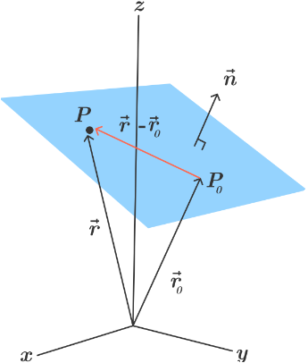
Planes in 3D Space
Consider the plane containing the point
and normal vector n = < a, b, c > perpendicular to the plane.

Slide 2
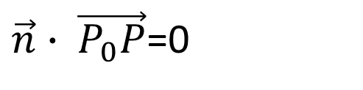
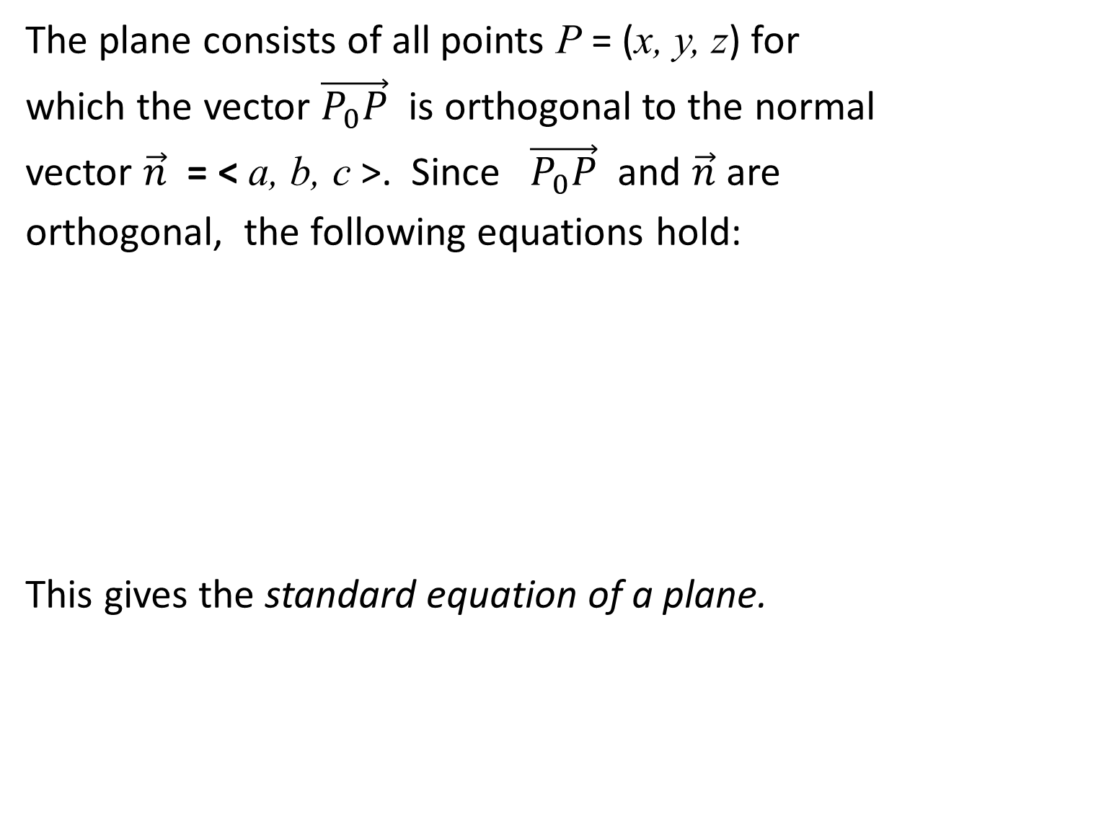
The plane consists of all points P = (x, y, z) for
which the vector $\vec{P_{0}P}$ is orthogonal to the normal
vector $\vec{n}$ = < a, b, c >. Since $\vec{P_{0}P}$ and $\vec{n}$ are
orthogonal, the following equations hold:
This gives the standard equation of a plane.
$\vec{n}∙ \vec{P_{0}P}$=0

Slide 3
If we expand this equation we obtain the following
equation:
Setting gives the general form
of the equation of a plane in 3D space
We summarize these results as follows.

Slide 4
Standard and General Equations of a Plane in 3D
space
The standard equation of a plane in 3D space has the
form
where is a point on the plane and n = < a, b, c >
is a vector normal (orthogonal to the plane). If this
equation is expanded, we obtain the general equation of
a plane of the form

Slide 5
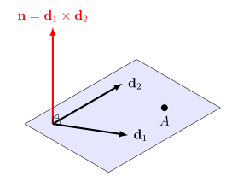
Note1 To write the equation of a plane in 3D
space, we need a point on the plane and a vector
normal (orthogonal) to the plane.
Note2 A single vector parallel to a plane is not enough to convey the ‘direction’ of the plane.
Note3 In a three-dimensional space, a plane can be defined by three points it contains, as long as those points are not on the same line

Slide 6
Intersecting Planes
Suppose we are given two intersecting planes
with angle between them.
Plane 1
Plane 2

Slide 7
Let and be normal vectors to these
planes. Then
Thus, two planes are
1. Perpendicular if , which implies .
2. Parallel if , where c is a scalar.

Slide 8
Notes
Given the general equation of a plane
the normal vector is n = < a, b, c >.
2. The intersection of two planes is a line.

Slide 9
Distance Between Points and a Plane
Suppose we are given a point Q not in a plane
and a point P on the plane and our goal is to find
the shortest distance between the point Q and the
plane.
Q
P

Slide 10
By projecting the vector onto the normal vector n (calculating the scalar projection we can find the distance D.
Q
P

Slide 11
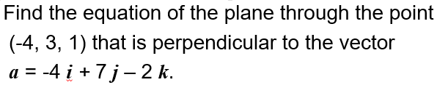

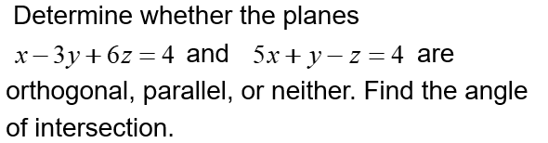
Practice 1
Determine the distance between the point P = (1, 2, 5) and the plane π: 3x + 4y + z + 7 = 0

